Slide 1
CELL ORGANELLES
Presented by
Dr. S. Deborah
Assistant Professor,
Department of Biotechnology,
Jamal Mohamed College,
Trichy-20
Mobile: 9952270978

Slide 2
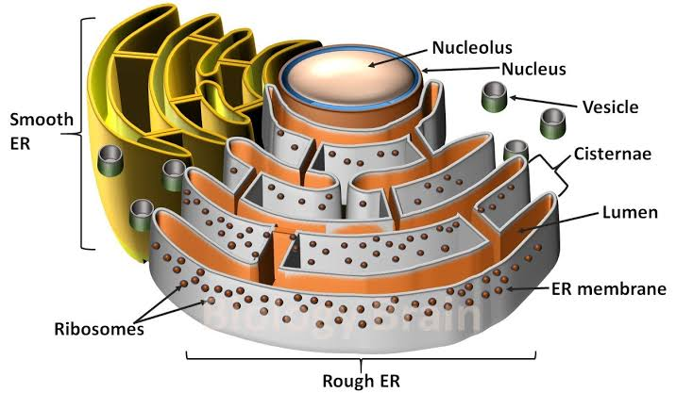
ENDOPLASMIC RETICULUM
endoplasmic reticulum (ER), in biology, a continuous membrane system that forms a series of flattened sacs within the cytoplasm of eukaryotic cells and serves multiple functions, being important particularly in the synthesis, folding, modification, and transport of proteins . All eukaryotic cells contain an endoplasmic reticulum (ER). In animal cells, the ER usually constitutes more than half of the membranous content of the cell. Differences in certain physical and functional characteristics distinguish the two types of ER, known as rough ER and smooth ER.

Slide 3
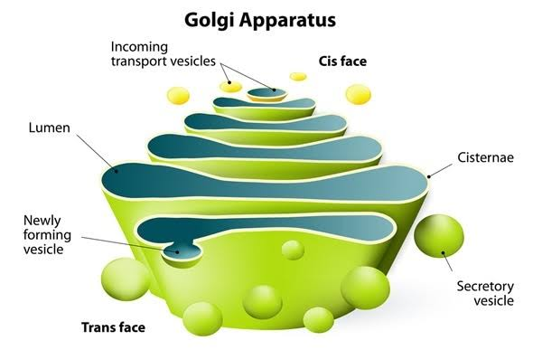
GOLGI APPARATUS
Golgi apparatus, also called Golgi complex or Golgi body, membrane-bound organelle of eukaryotic cells (cells with clearly defined nuclei) that is made up of a series of flattened, stacked pouches called cisternae. The Golgi apparatus is responsible for transporting, modifying, and packaging proteins and lipids into vesicles for delivery to targeted destinations. It is located in the cytoplasm next to the endoplasmic reticulum and near the cell nucleus. While many types of cells contain only one or several Golgi apparatus, plant cells can contain hundreds.

Slide 4
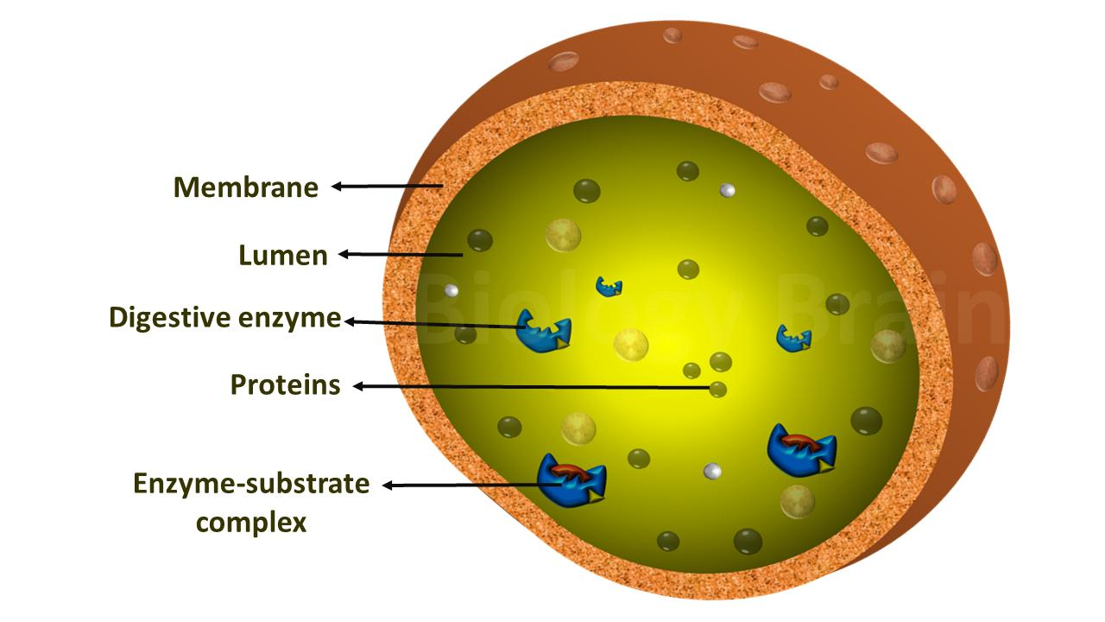
LYSOSOMES
The lysosome is a specific type of organelle that's very acidic. So that means that it has to be protected from the rest of the inside of the cell. It's a compartment, then, that has a membrane around it that stores the digestive enzymes that require this acid, low-pH environment. Those enzymes are called hydrolytic enzymes, and they break down large molecules into small molecules. For example, large proteins into amino acids, or large carbohydrates into simple sugars, or large lipids into single fatty acids. And when they do that, they provide for the rest of the cell the nutrients

Slide 5
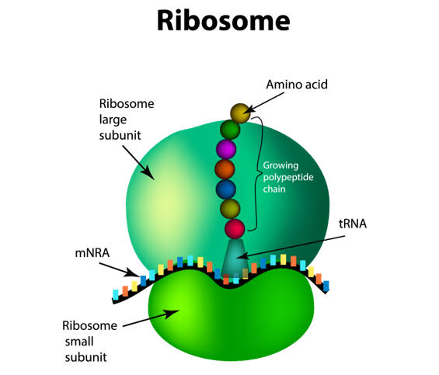
RIBOSOME
A ribosome is the cellular machinery responsible for making proteins. There are many ribosomes in each cell, each made up of two subunits. These two subunits lock around the messenger RNA and then travel along the length of the messenger RNA molecule reading each three-letter codon. The ribosome serves as a docking station for the transfer RNA that matches the sequence of bases on the messenger RNA. Each three-letter codon on the messenger RNA pairs with the matching anticodon on a specific transfer RNA, and that specific RNA allows for the addition of a specific amino acid on the end of the growing protein chain. The ribosome then breaks up after the completion of the protein.

Slide 6
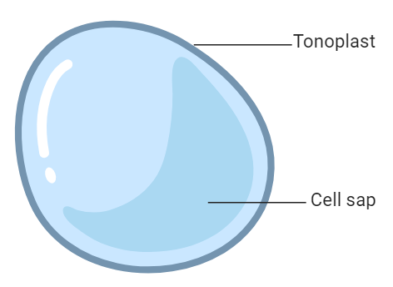
VACUOLES
Vacuoles are membrane-bound organelles that can be found in both animals and plants. In a way, they're specialized lysosomes. That is to say that their function is really to handle waste products, and by handle, mean take in waste products and also get rid of waste products. Sometimes the waste product is water, and therefore a vacuole would have as its function to maintain the balance of water inside and outside a cell. Sometimes a vacuole's function is to get rid of harmful toxins or to clear the extracellular space of those harmful toxins by bringing them into the cell for conversion; for chemical conversion into more safe compounds. The vacuoles are quite common in plants and animals, and humans have some of those vacuoles as well. But vacuole also has a more generic term, meaning a membrane-bound organelle that's lysosome-like.

Slide 7
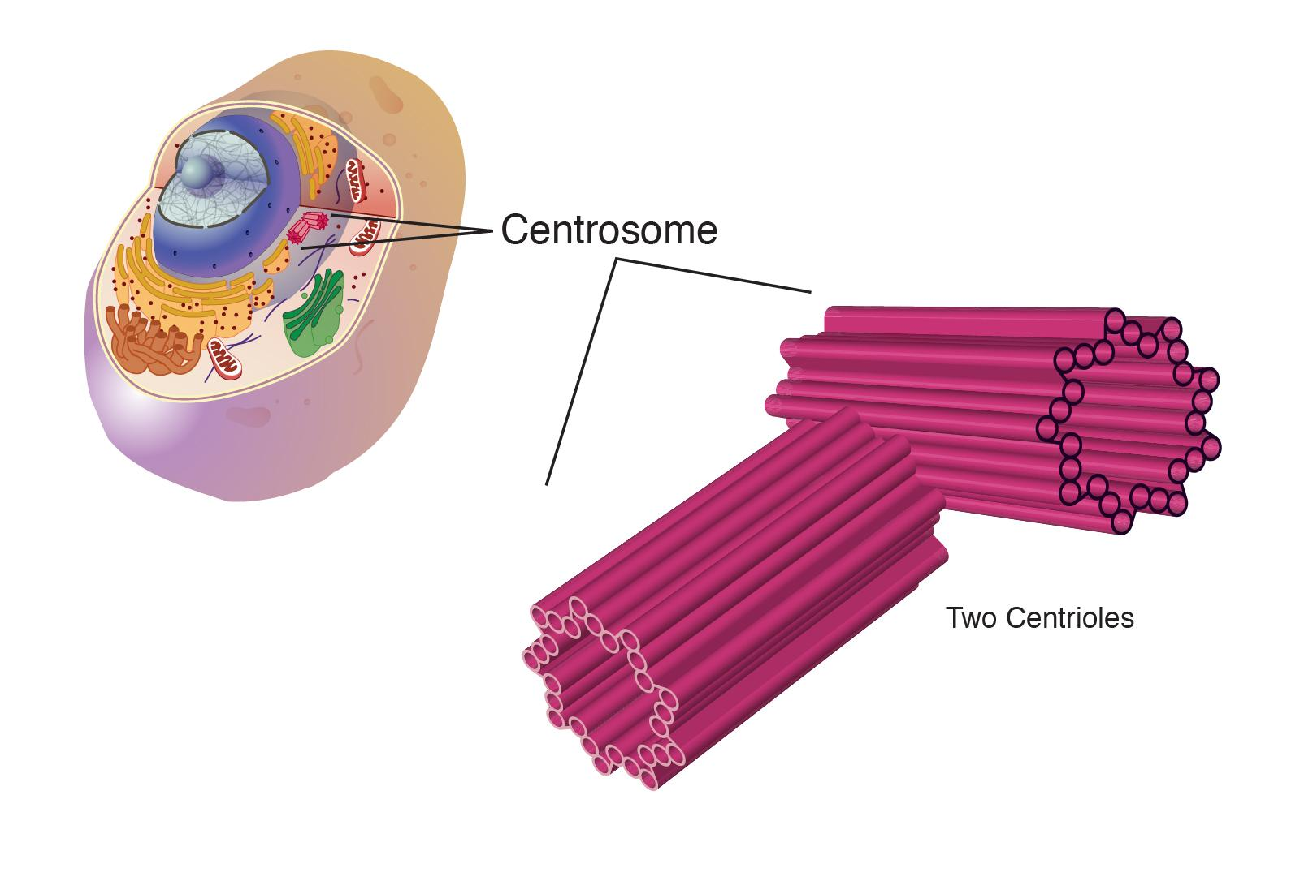
CENTROSOME
The centrosome is an important part of how the cell organizes the cell division. There are a lot of processes that need to be coordinated together when you have two cells, both their nucleus and the cytoplasm, moving away from each other. Microtubules create a spindle, and that's really the structural elements of the cell that coordinate the cells moving away from each other. And the centrosomes organize the microtubules, so it's called the microtubules organizing center. The centrosomes duplicate before cell division, so they then help to organize the microtubules and the cell division process

Slide 8
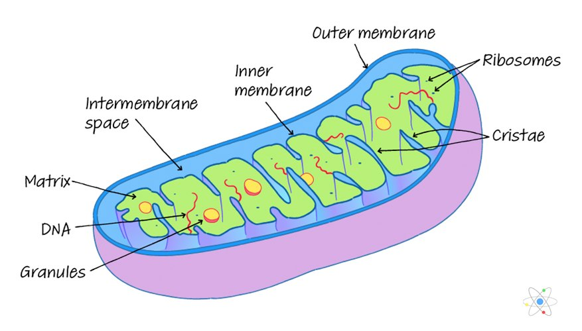
MITOCHONDRIA
Mitochondria are membrane-bound organelles, but they're membrane-bound with two different membranes. And that's quite unusual for an intercellular organelle. Those membranes function in the purpose of mitochondria, which is essentially to produce energy. That energy is produced by having chemicals within the cell go through pathways, in other words, be converted. And the process of that conversion produces energy in the form of ATP, because the phosphate is a high-energy bond and provides energy for other reactions within the cell. So the mitochondria's purpose is to produce that energy. Some different cells have different amounts of mitochondria because they need more energy. So for example, the muscle has a lot of mitochondria, the liver does too, the kidney as well, and to a certain extent, the brain, which lives off of the energy those mitochondria produce

Slide 9
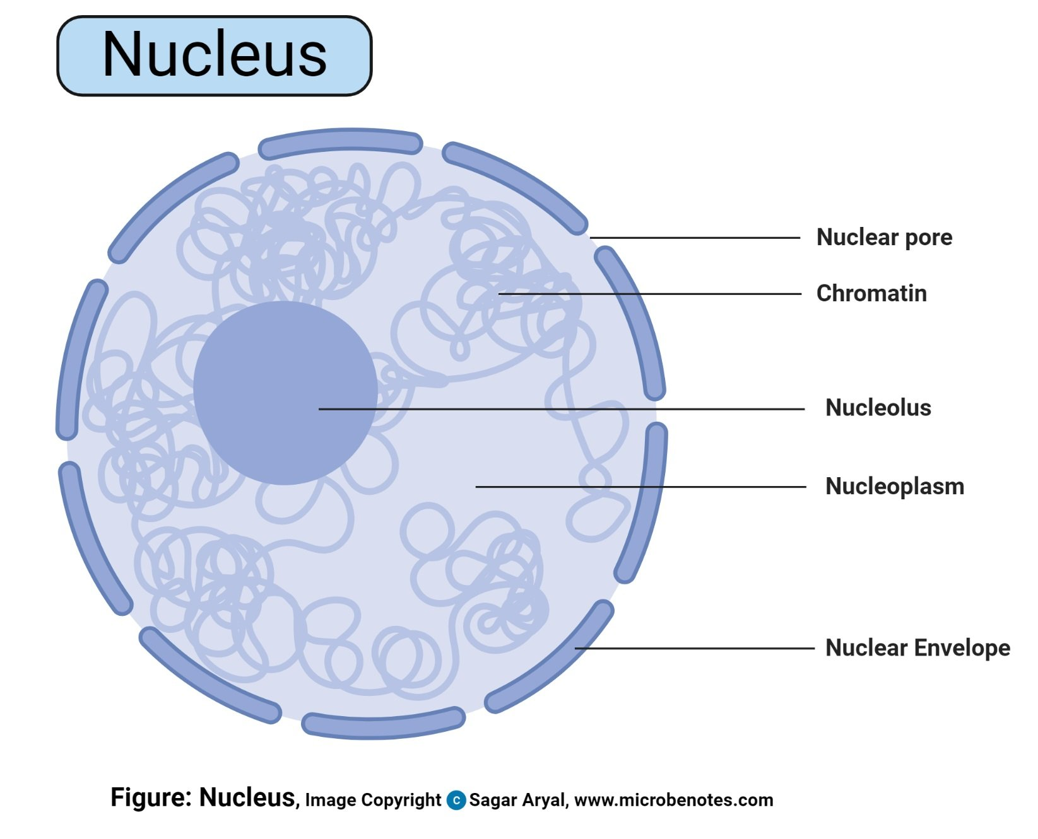
NUCLEUS
The nucleus is one of the most obvious parts of the cell when you look at a picture of the cell. It's in the middle of the cell, and the nucleus contains all of the cell's chromosomes, which encode the genetic material. So this is really an important part of the cell to protect. The nucleus has a membrane around it that keeps all the chromosomes inside and makes the distinction between the chromosomes being inside the nucleus and the other organelles and components of the cell staying outside. Sometimes things like RNA need to traffic between the nucleus and the cytoplasm, and so there are pores in this nuclear membrane that allow molecules to go in and out of the nucleus. It used to be thought that the nuclear membrane only allowed molecules to go out, but now it's realized that there is an active process also for bringing molecules into the nucleus.

Slide 10
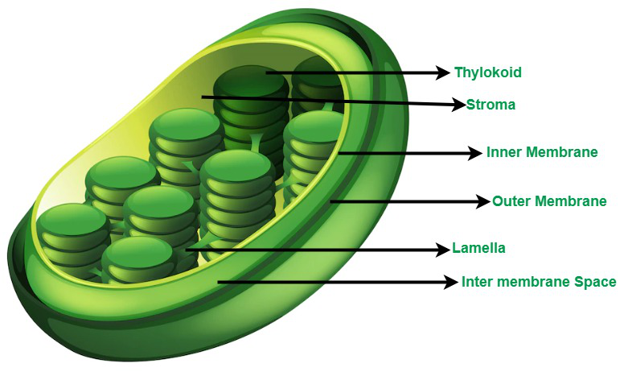
PLASTIDS
Plastid is a double membrane-bound organelle involved in the synthesis and storage of food, commonly found within the cells of photosynthetic plants.
Plastids were discovered and named by Ernst Haeckel, but A. F. W. Schimper was the first to provide a clear definition.
They are necessary for essential life processes, like photosynthesis and food storage.
A plastid containing green pigment (chlorophyll) is called chloroplast whereas a plastid containing pigments apart from green is called a chromoplast. A plastid that lacks pigments is called a leucoplast and is involved mainly in food storage.

